Slide 1


HR Hive
Streamlining Your Human Resource
Management Processes
(Industrial Project)
Department of Computer Science
COMSATS University Islamabad, Wah Campus

Slide 2

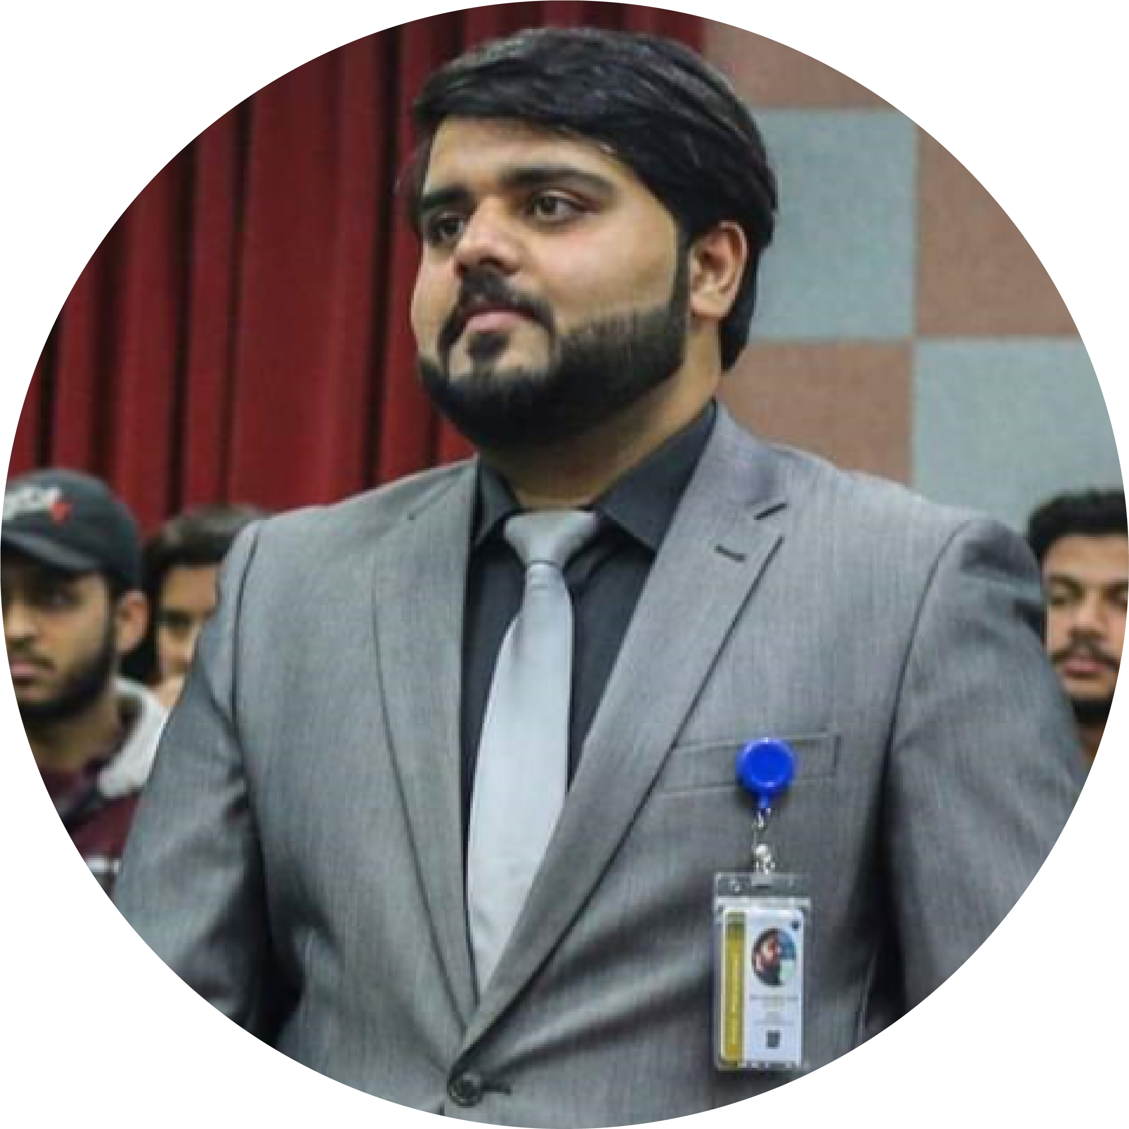
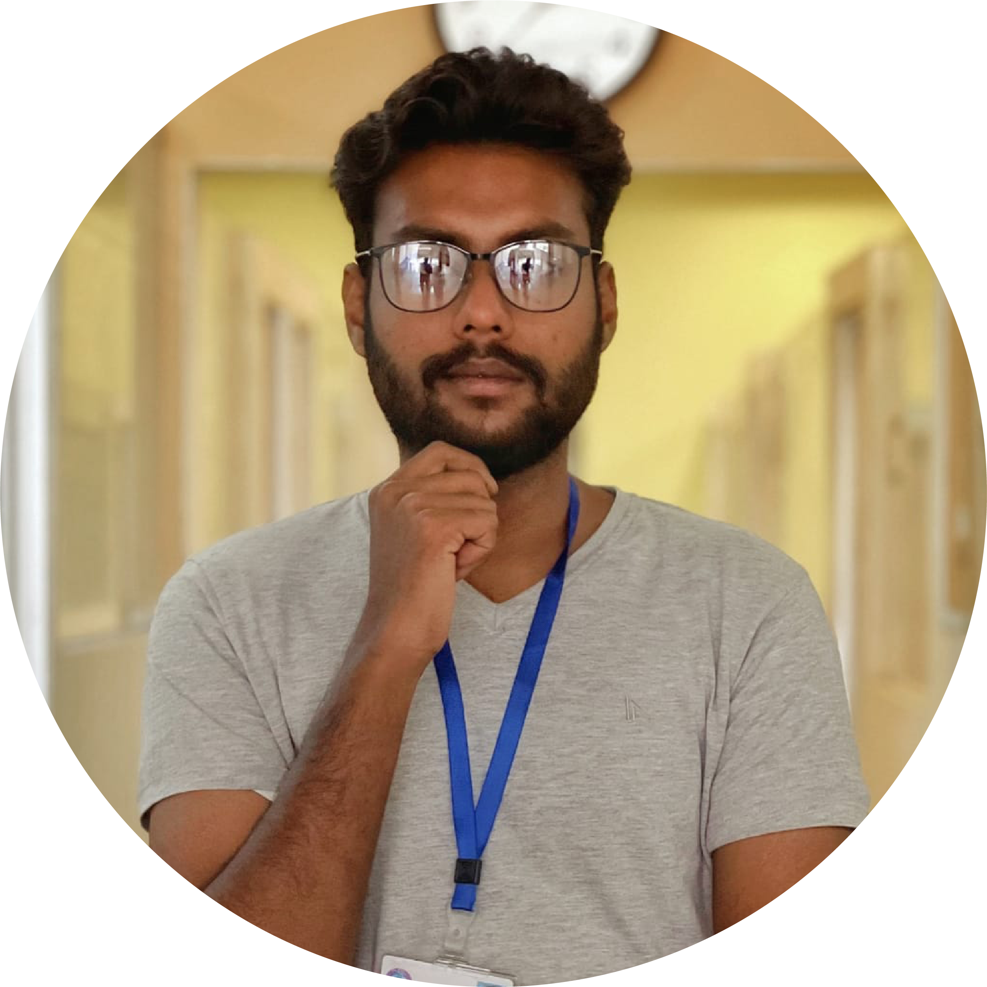
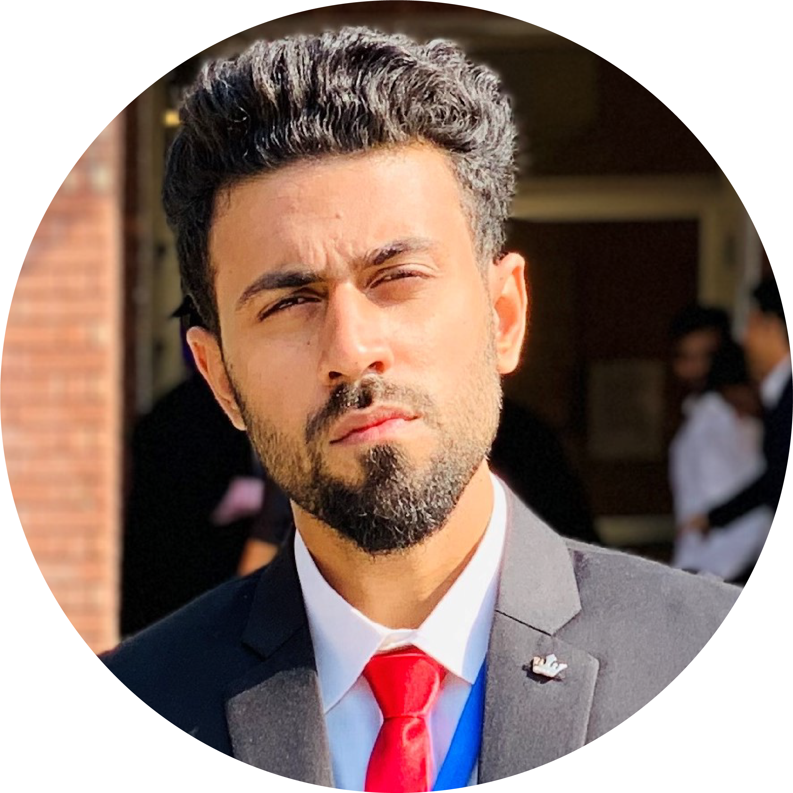
Meet Our Team

Slide 3


Meet Our Team

Slide 4
Meet Our Team
Mian Muhammad
Talha
SUPERVISOR
LECTURER
COMPUTER SCIENCE DEPTT.

Slide 5
Meet Our Team
Aloysius Joseph
Farnon
SP19 – BCS – 173
TEAM LEADER

Slide 6
Meet Our Team
NOUMAN ALI
SP20 – BSE – 013
TEAM MEMBER

Slide 7

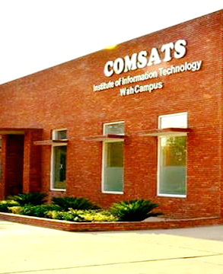
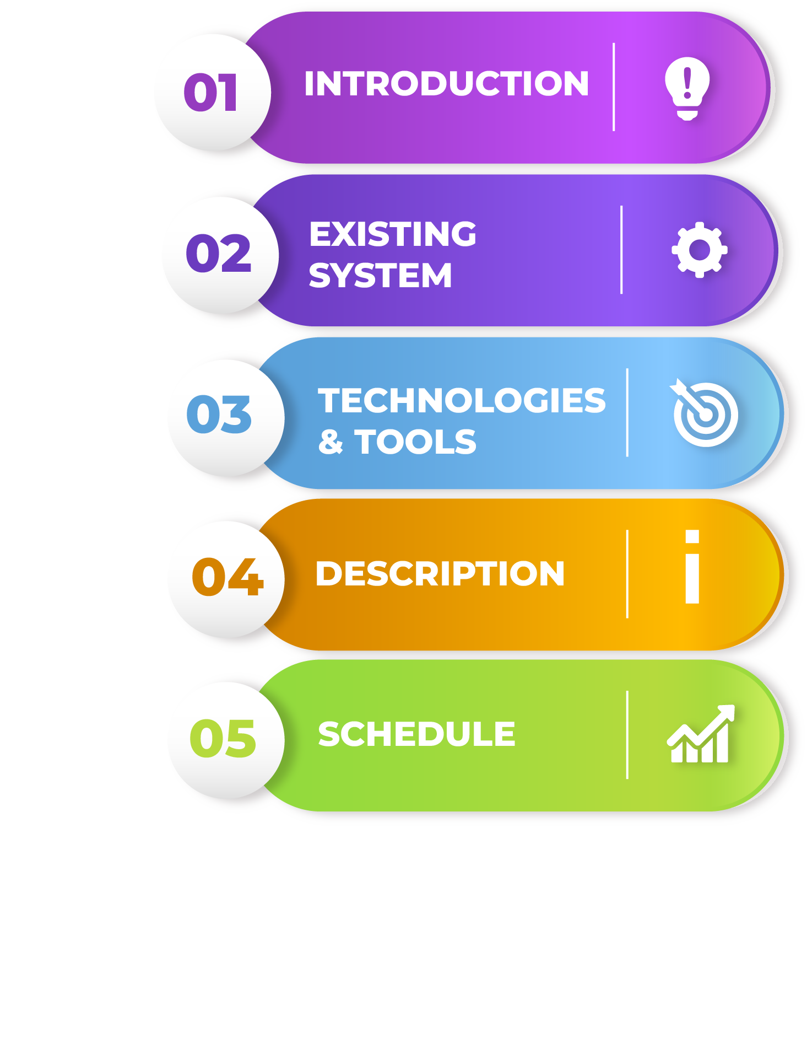

Slide 8

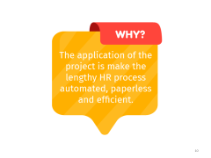
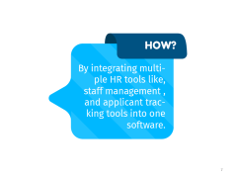
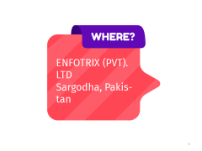



Introduction

Slide 9


Slide 10
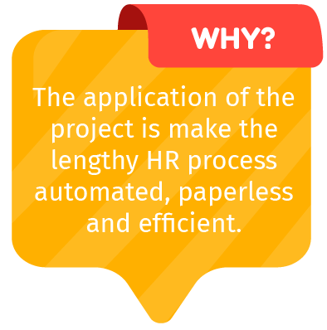

Slide 11
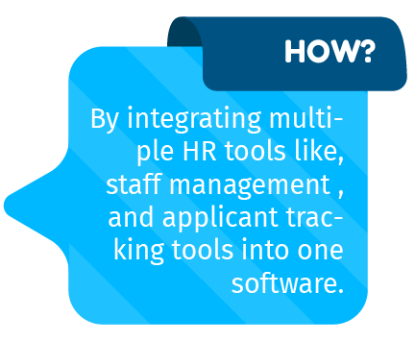

Slide 12
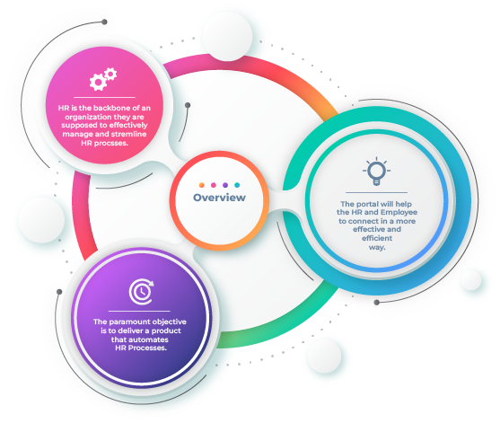
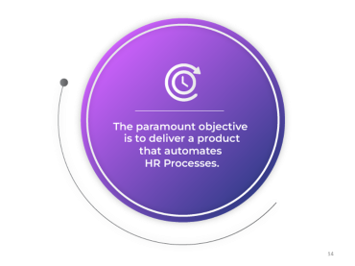
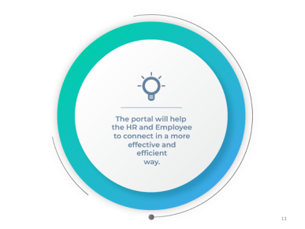
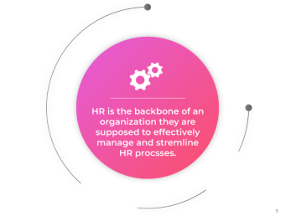



Introduction

Slide 13


Slide 14
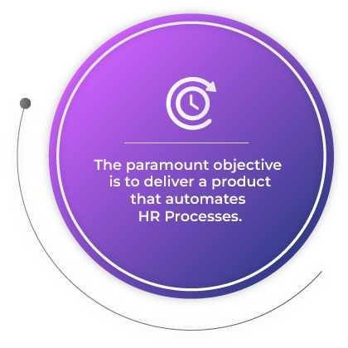

Slide 15
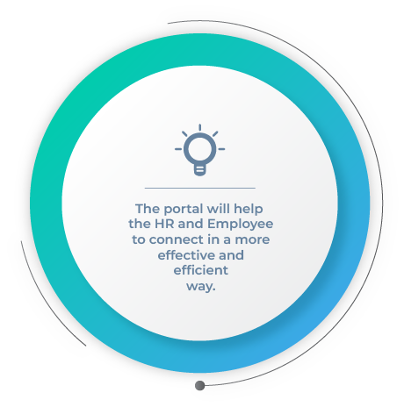

Slide 16
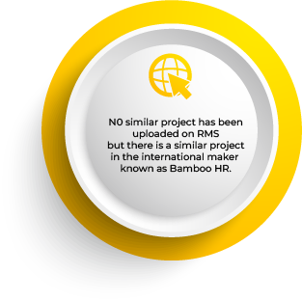
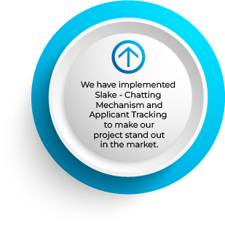
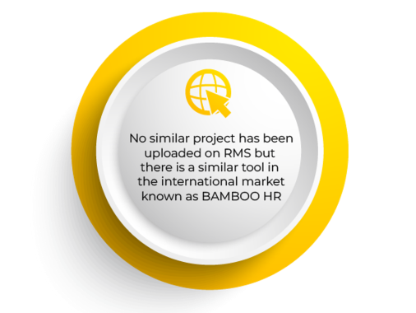

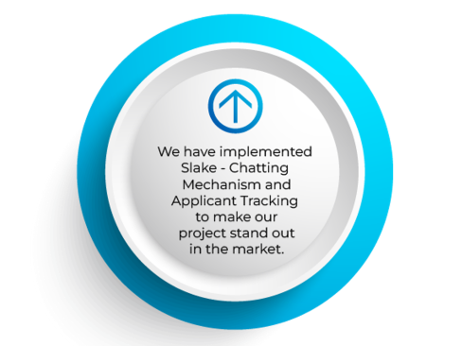

Existing Systems & Our Contribution
Department of Computer Science, CUI Wah Campus

Slide 17


Slide 18


Slide 19
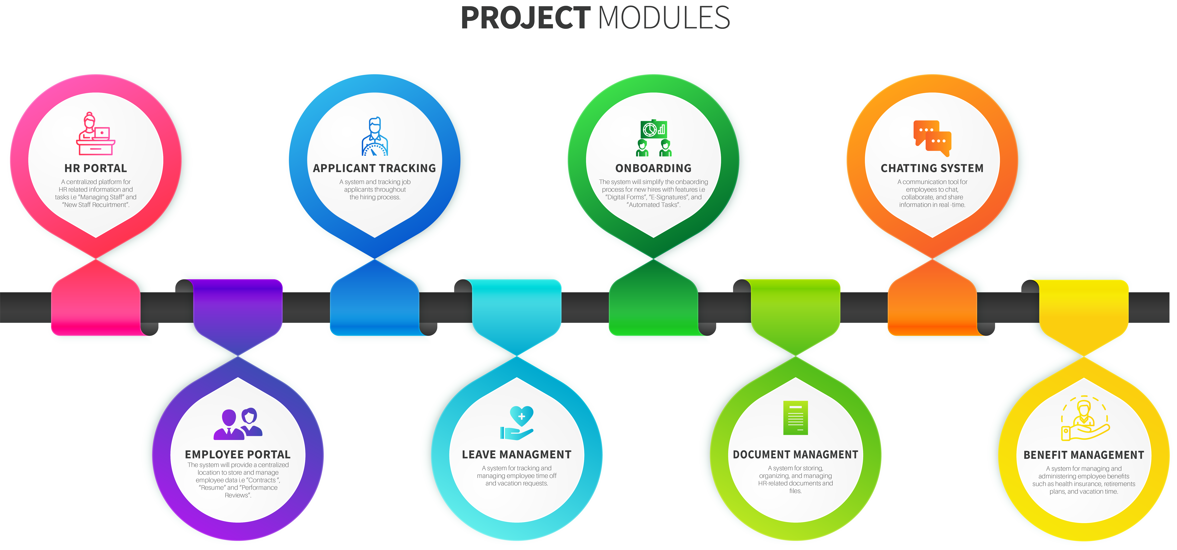
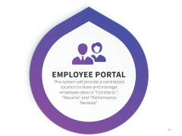
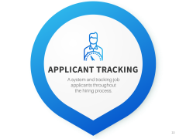

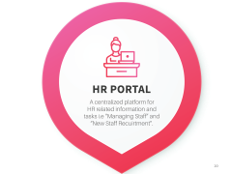
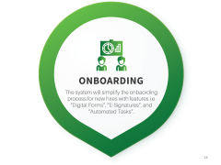


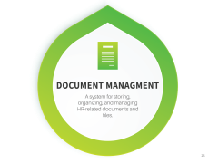




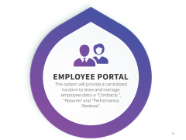


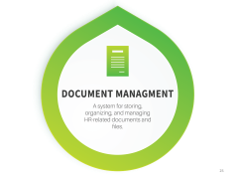
Brief Description
Department of Computer Science, CUI Wah Campus

Slide 20


Slide 21
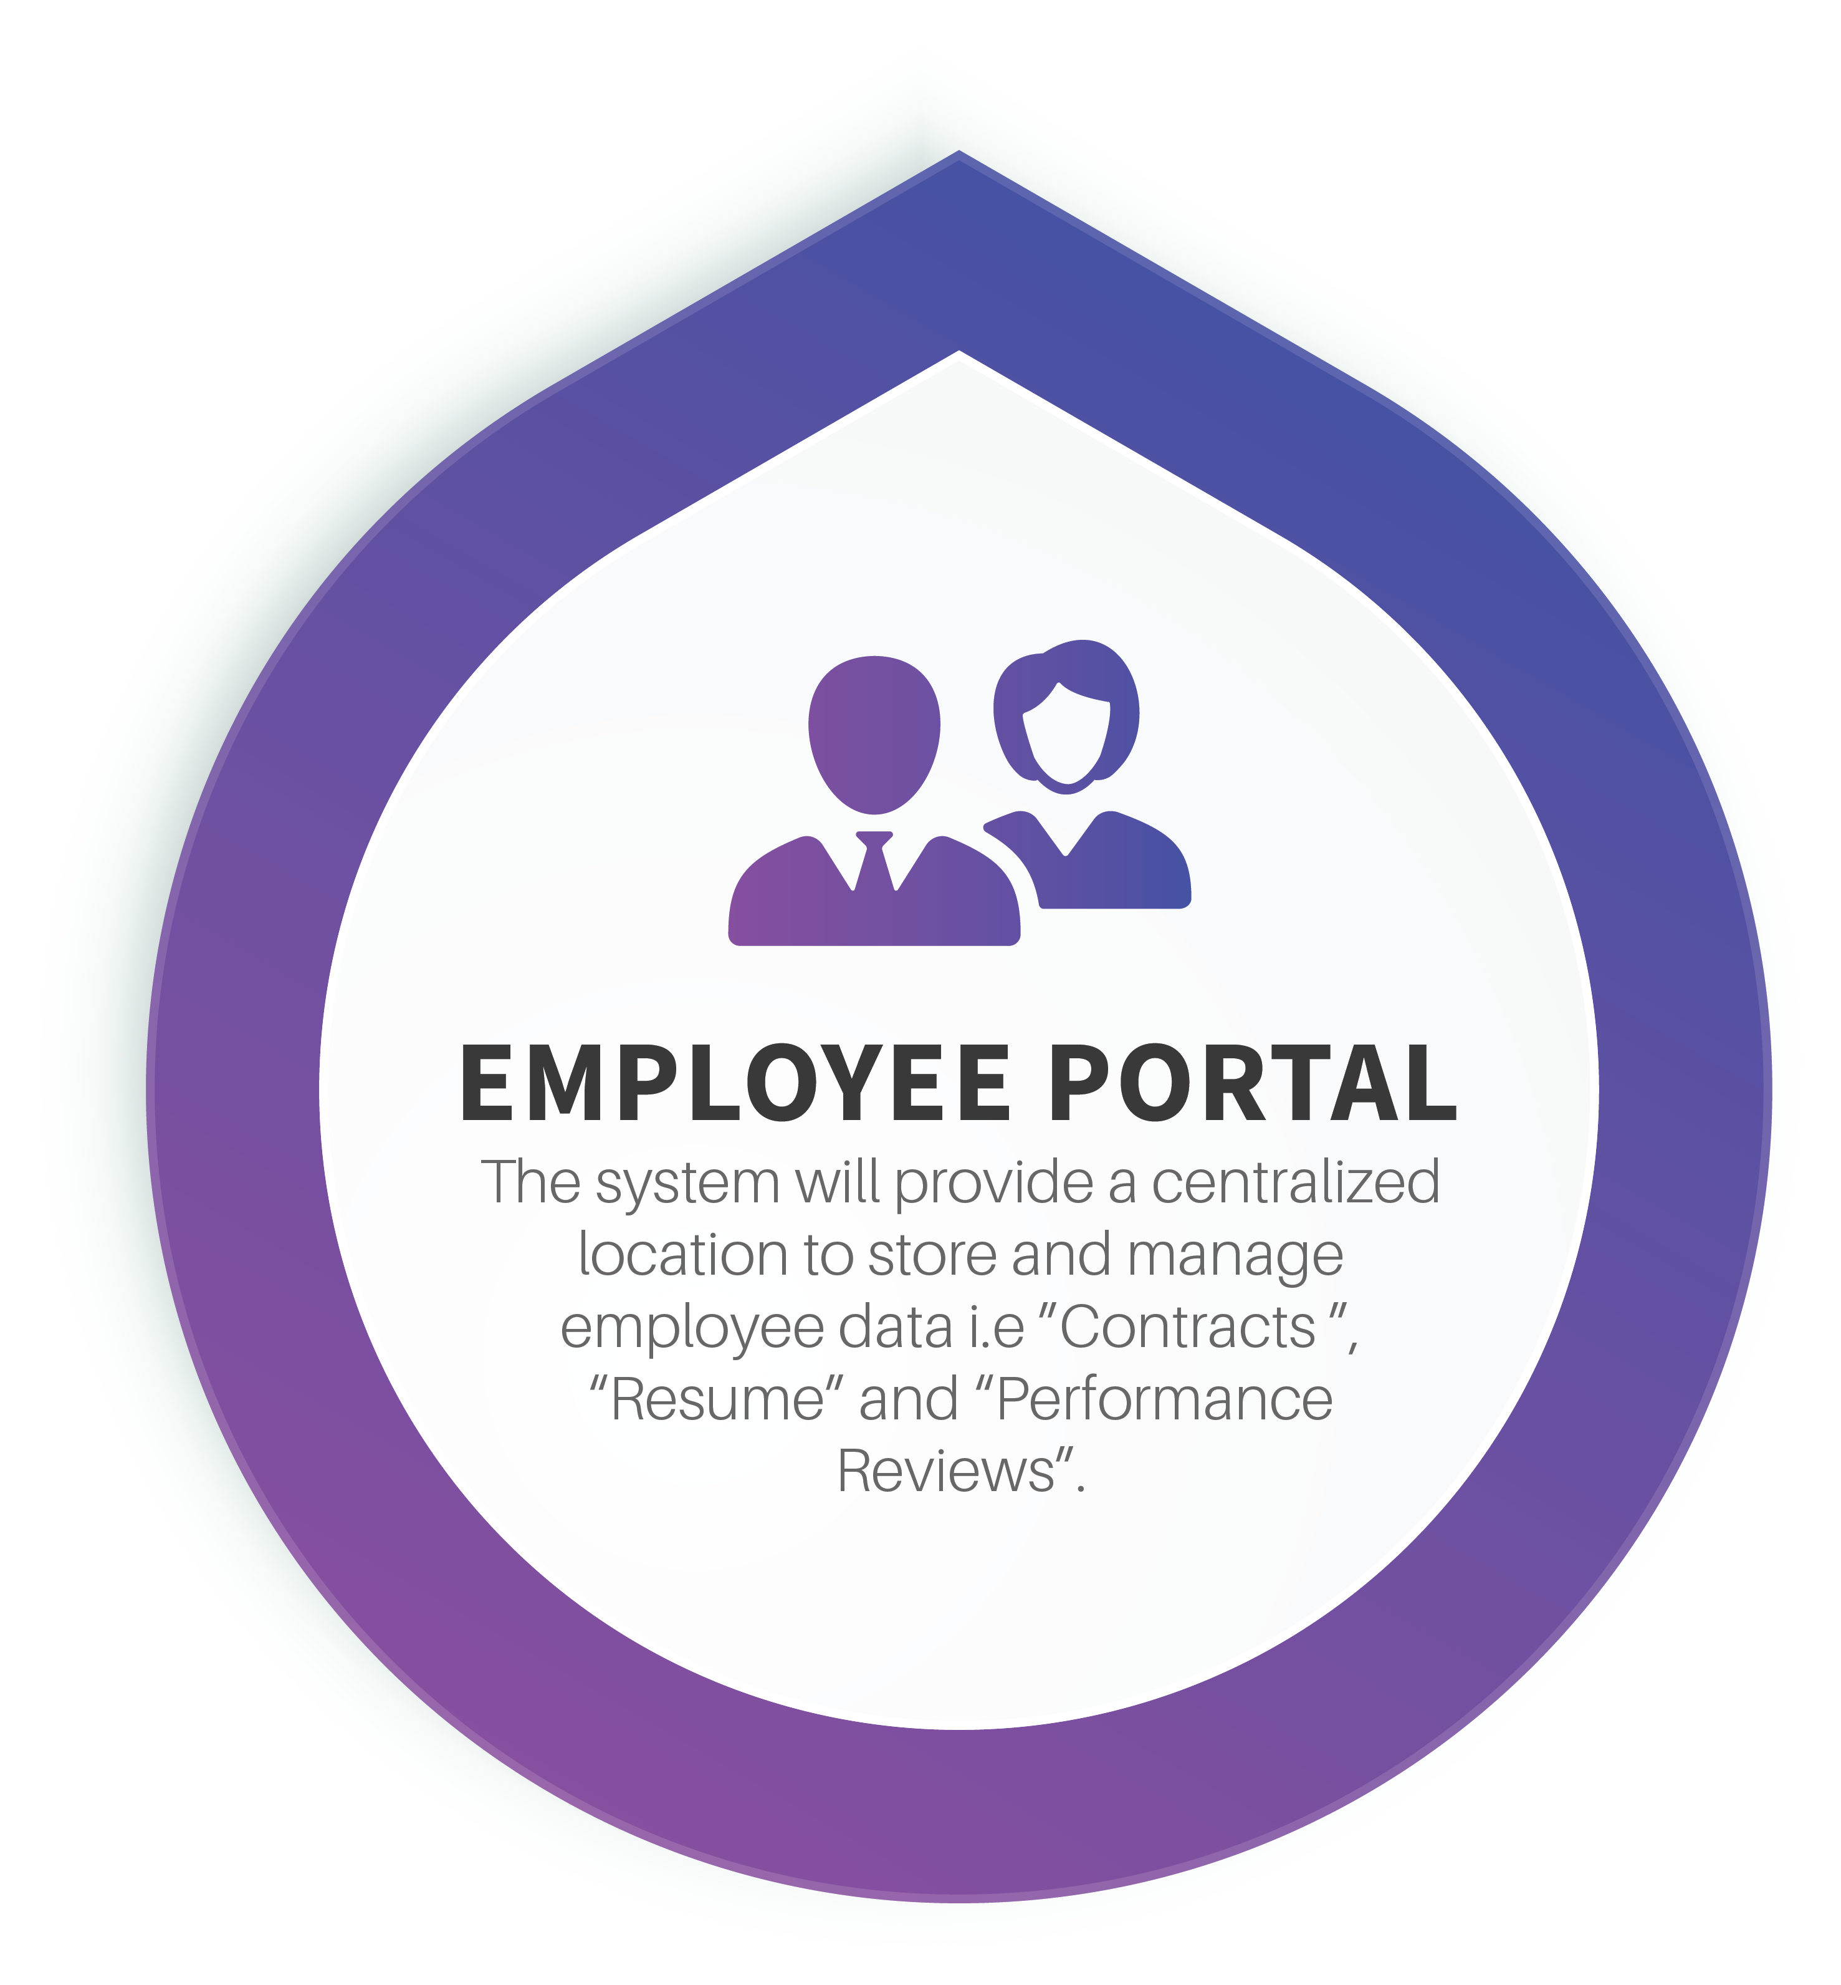

Slide 22
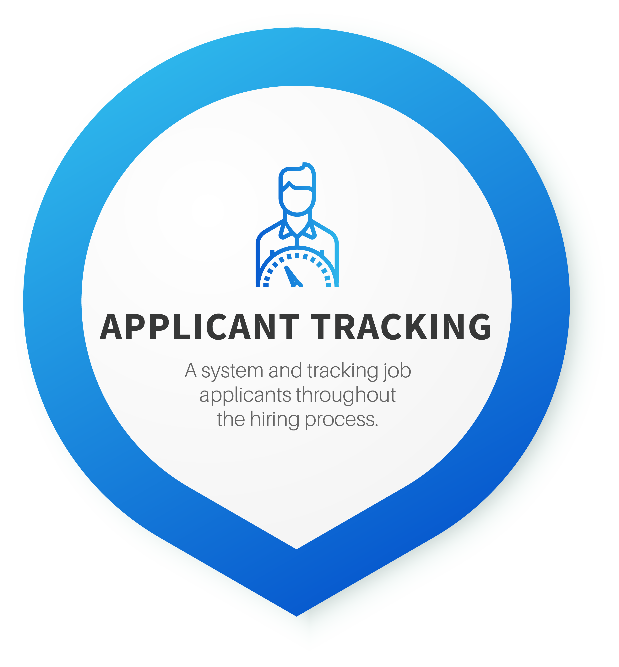

Slide 23


Slide 24
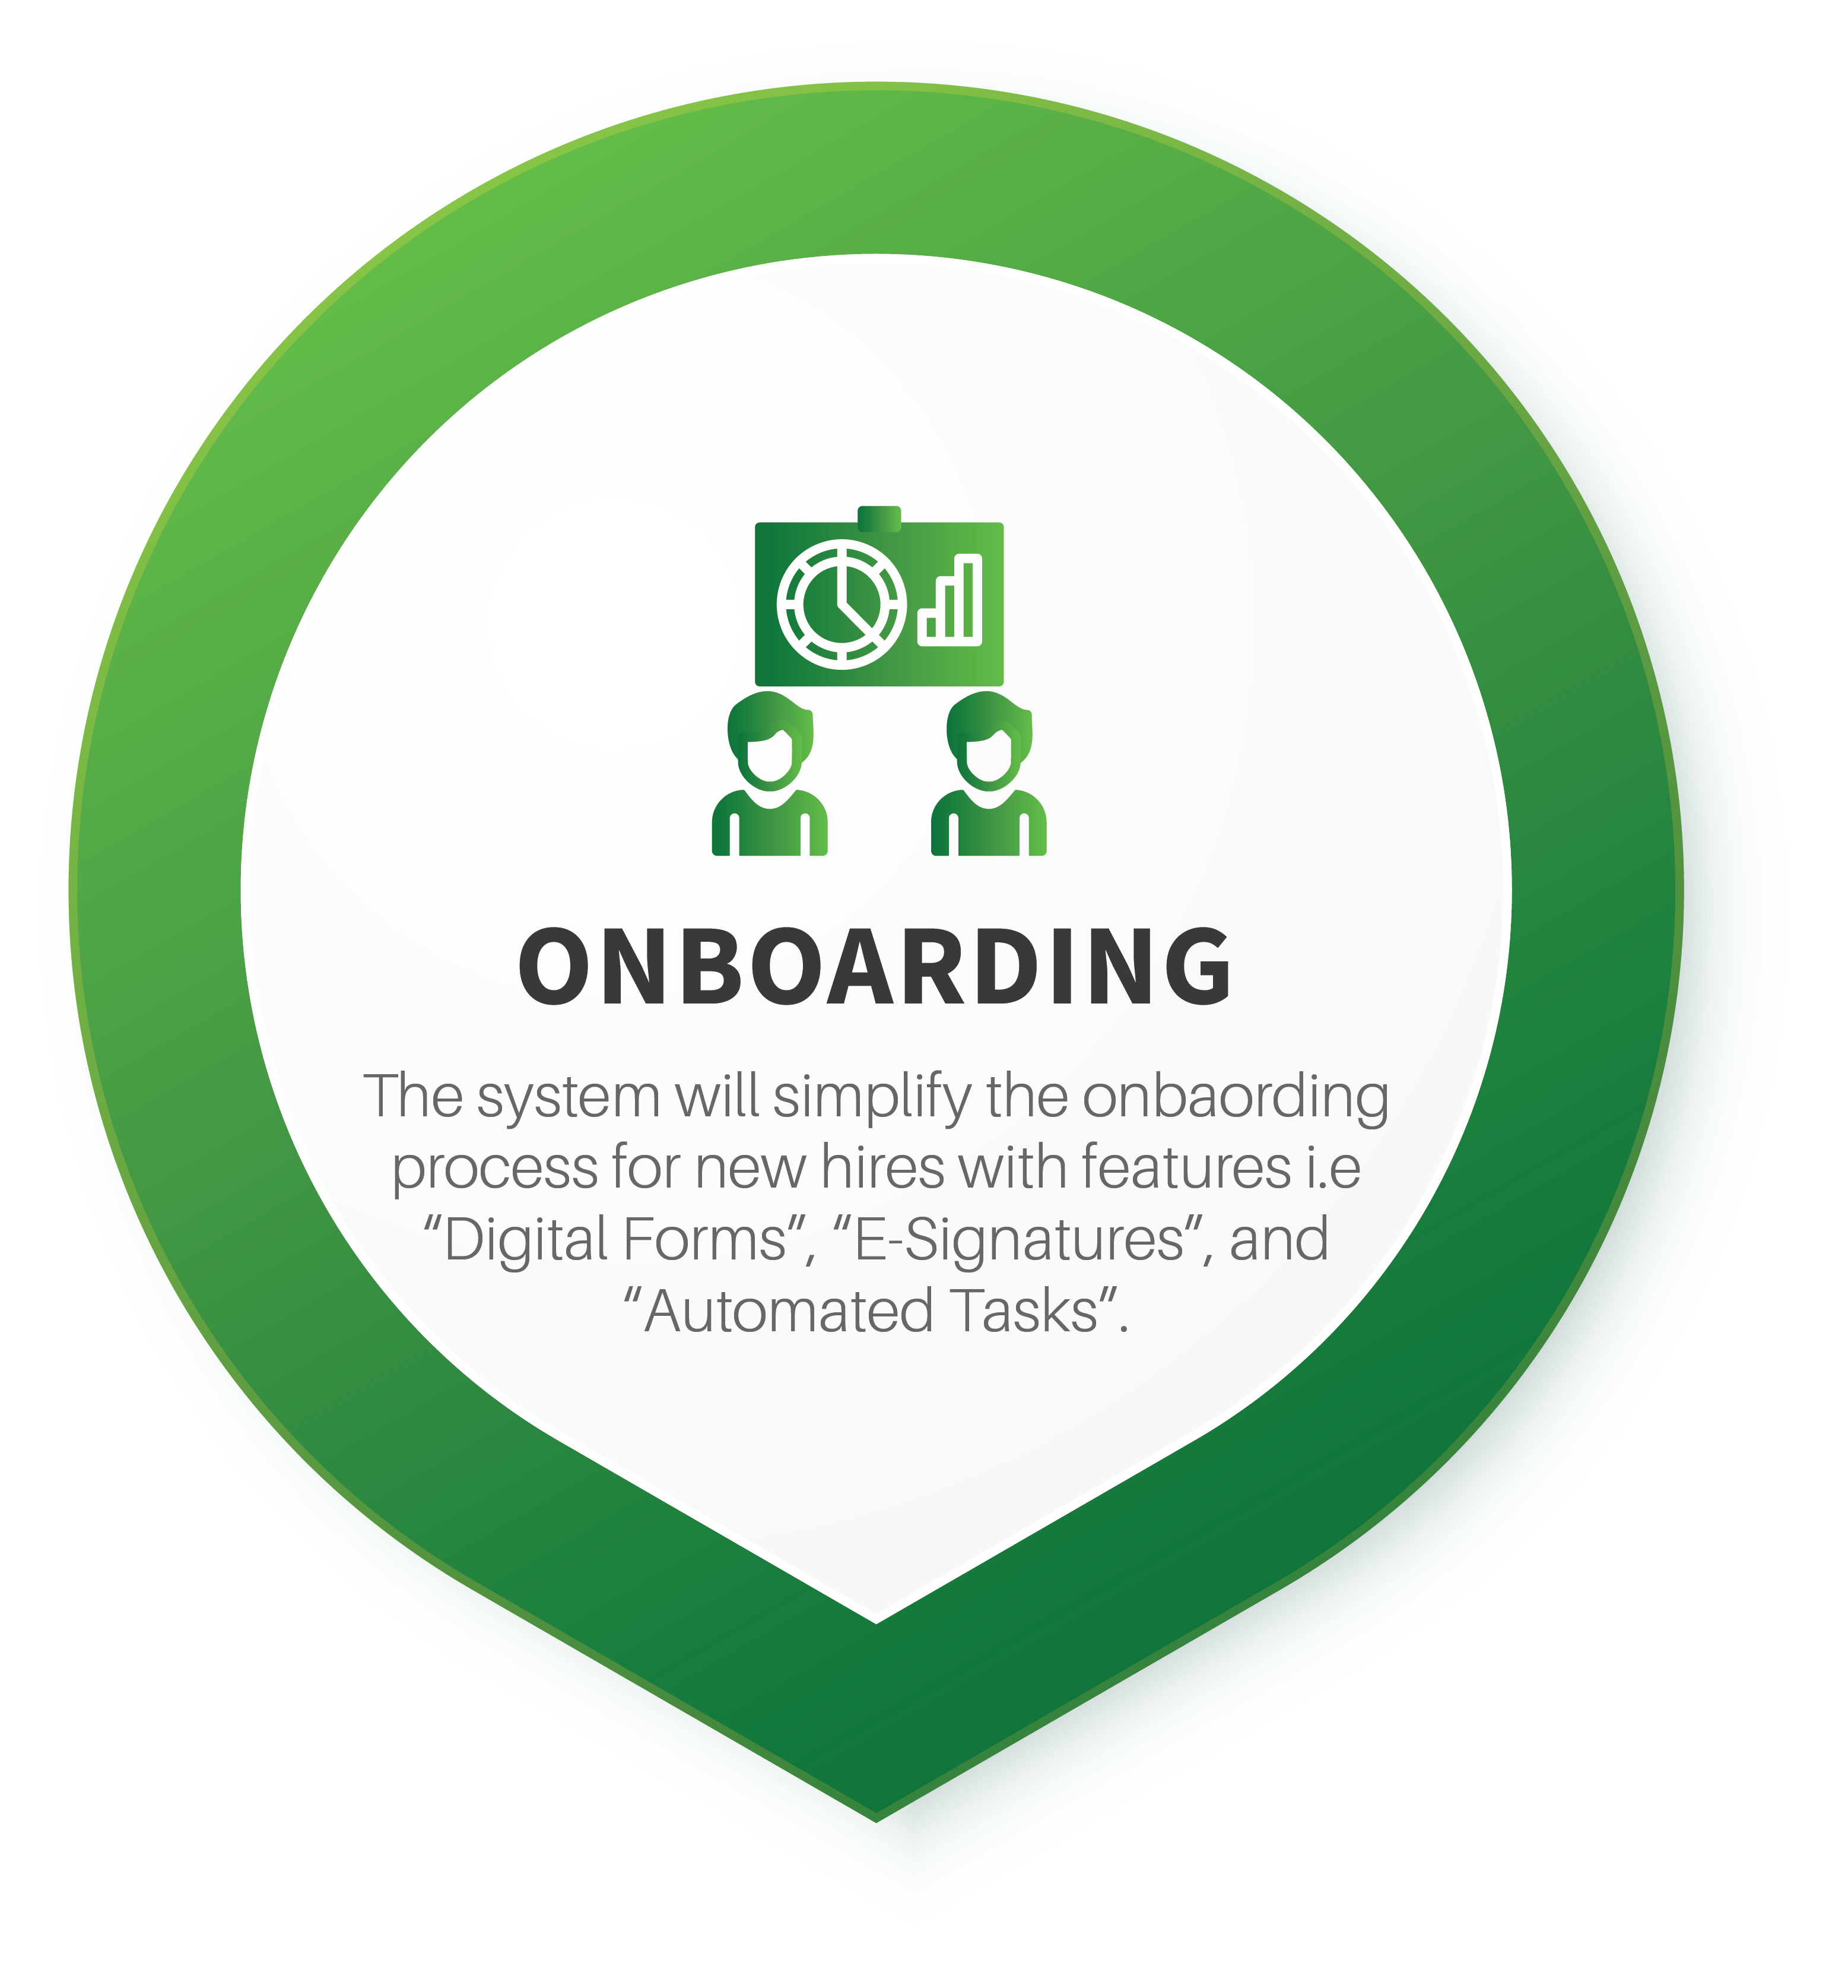

Slide 25
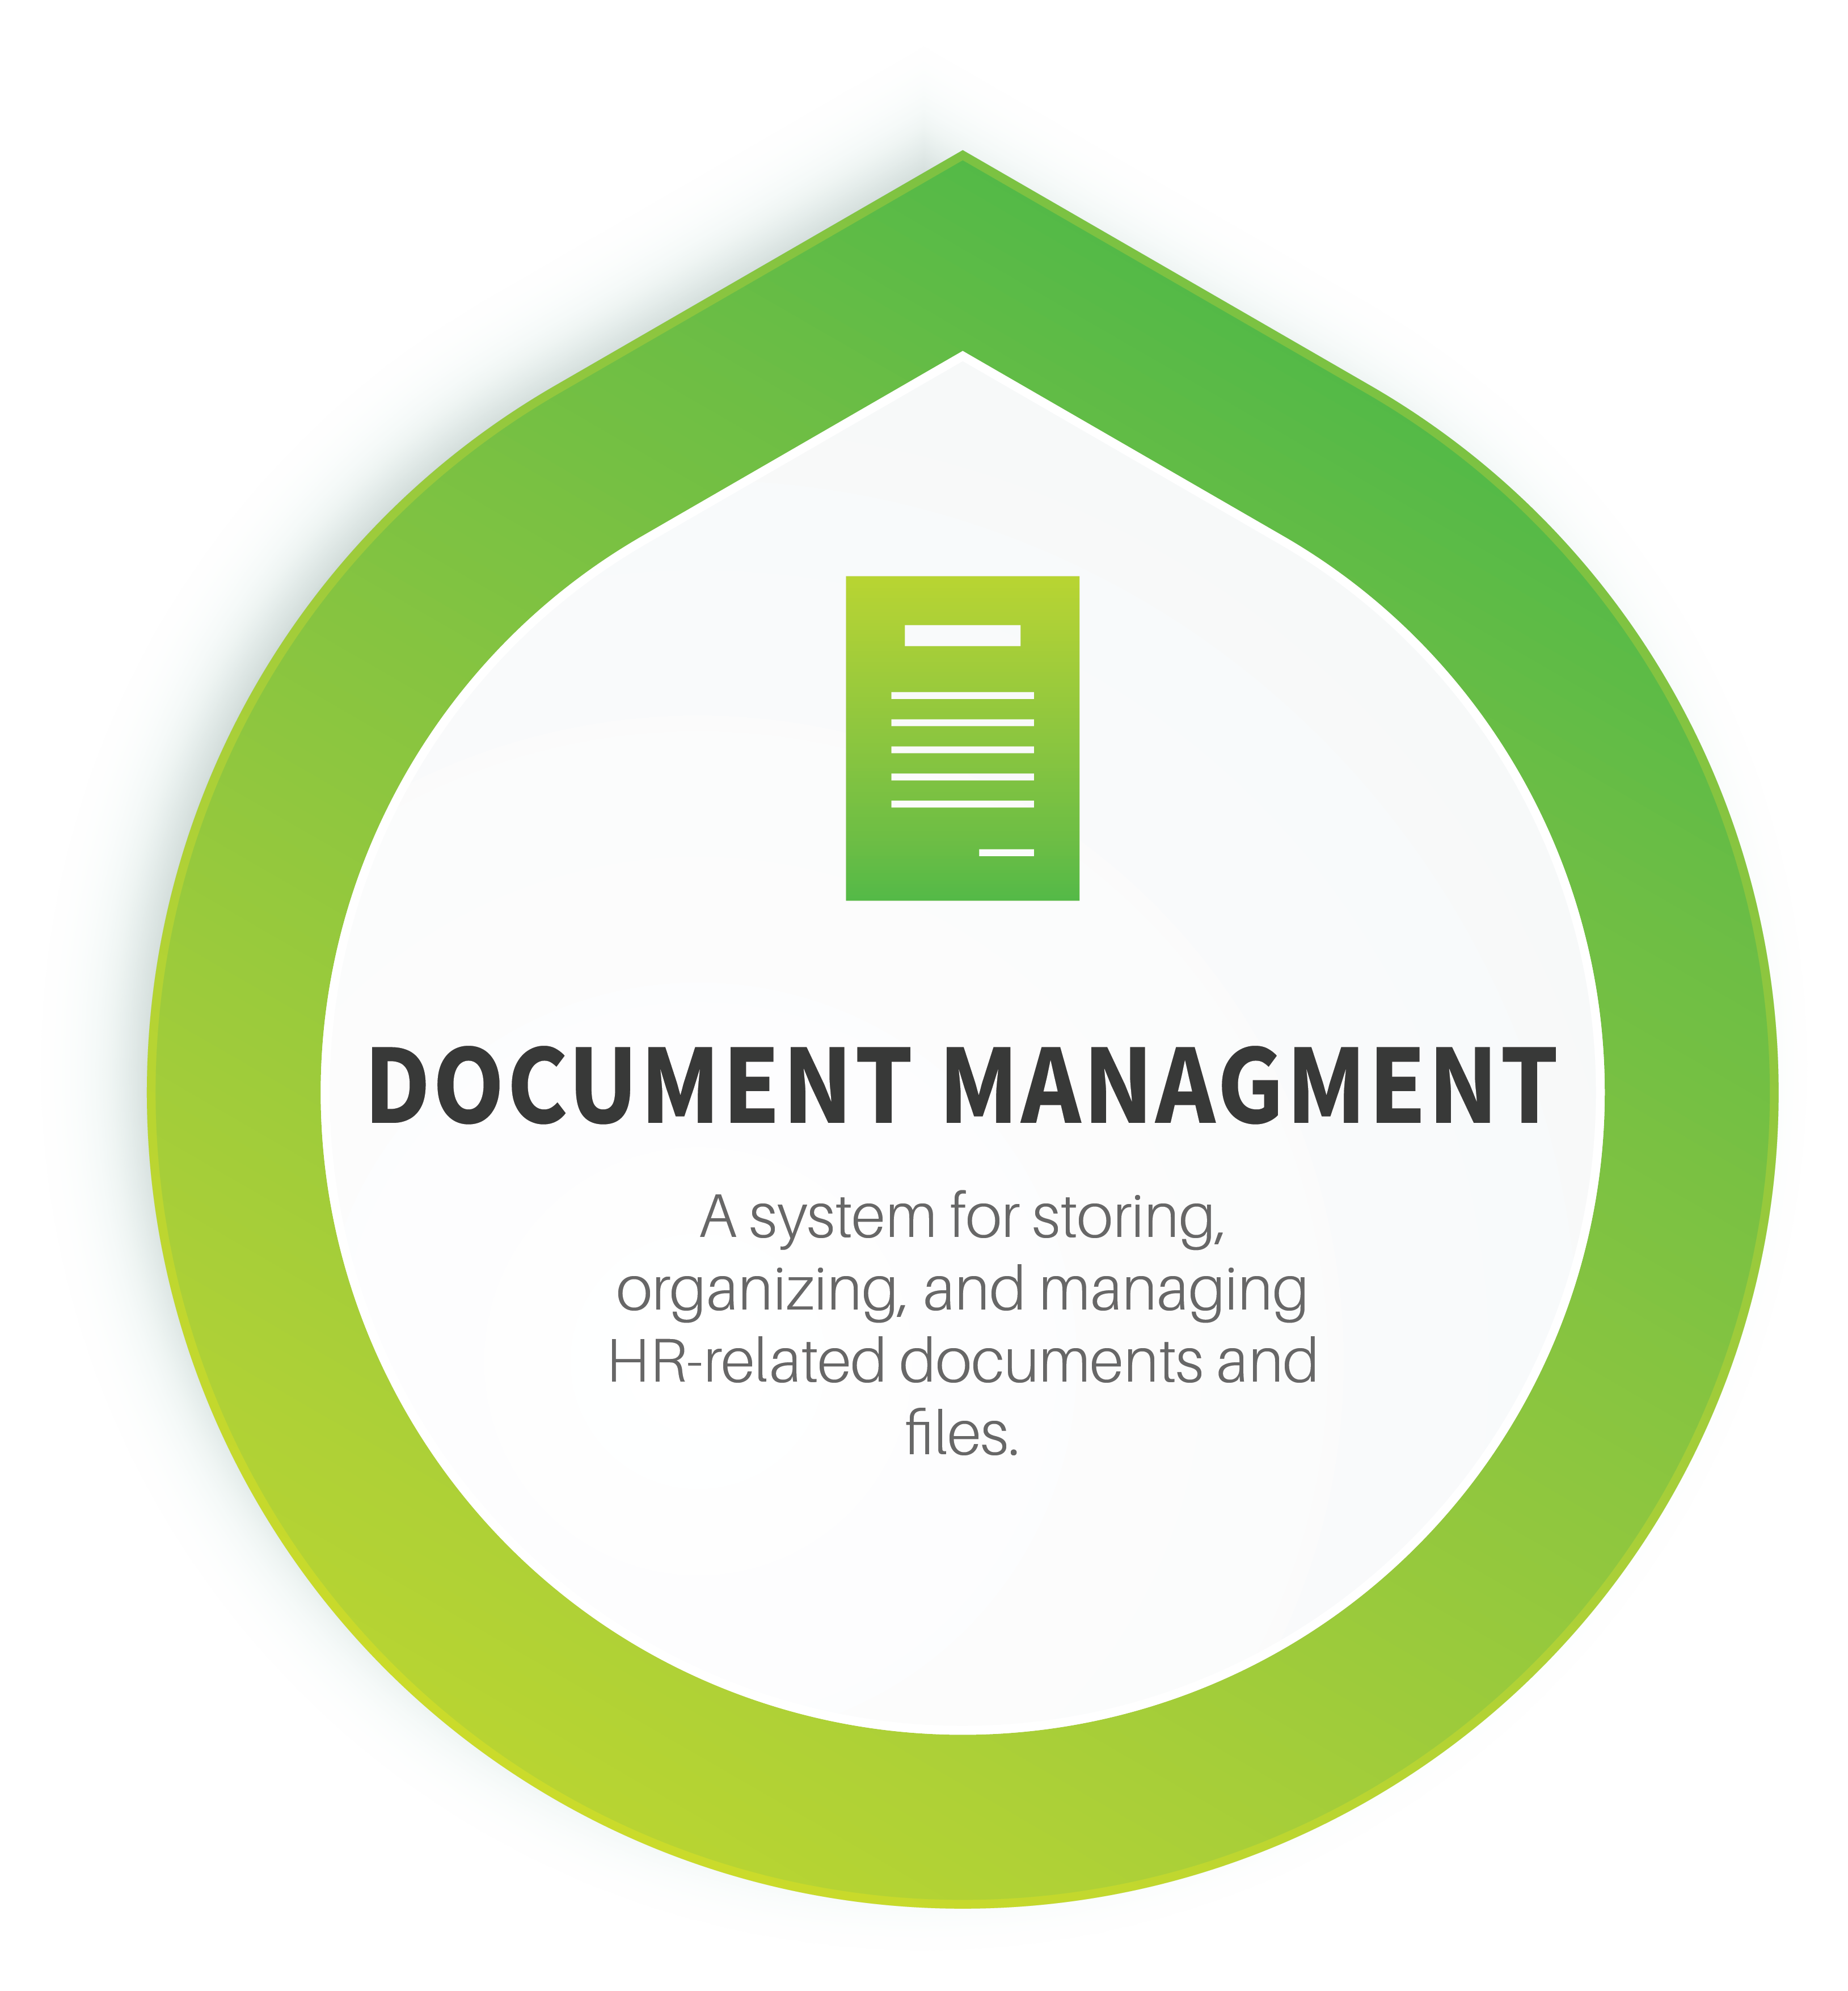

Slide 26


Slide 27


Slide 28








Technologies & Tools
Languages:
Design Tools:
Database:

Slide 29

Department of Computer Science
COMSATS University Islamabad, Wah Campus

Slide 30
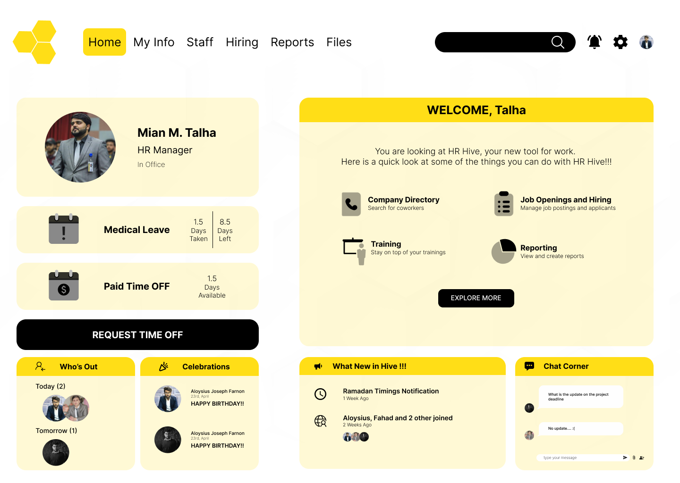
Department of Computer Science
COMSATS University Islamabad, Wah Campus

Slide 31
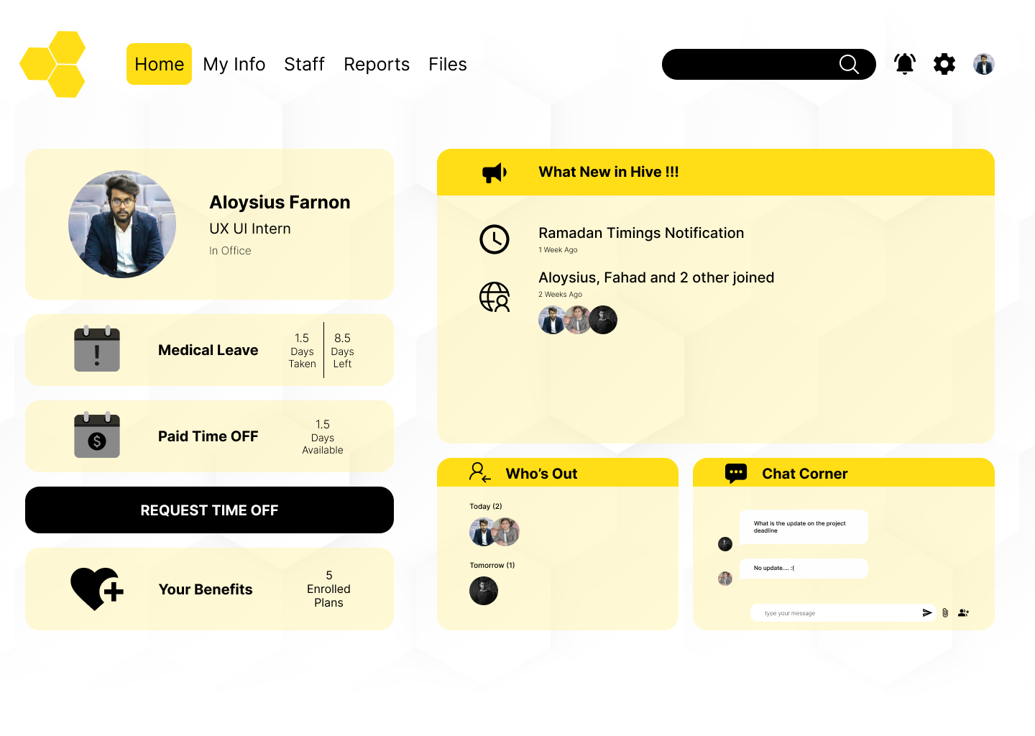
Department of Computer Science
COMSATS University Islamabad, Wah Campus

Slide 32
Project Schedule
Sr. No. | Semester | Milestone | Deliverables | Deadline
1 | VII | Proposal | Document | March 2023
2 | VII | Software Requirement Specification & Design Specification | Document | May 2023
3 | VII | Implementation of 25% of the Functional Requirements | Working Software | June-July 2023
4 | VIII | Implementation of 90-100% of the Functional Requirements + FYP Report | Working Software + Document | Nov 2023
5 | VIII | Final Project Presentation + Final FYP Report | Complete Software + Document | Dec-Jan 2023
Department of Computer Science, CUI Wah Campus

Slide 33
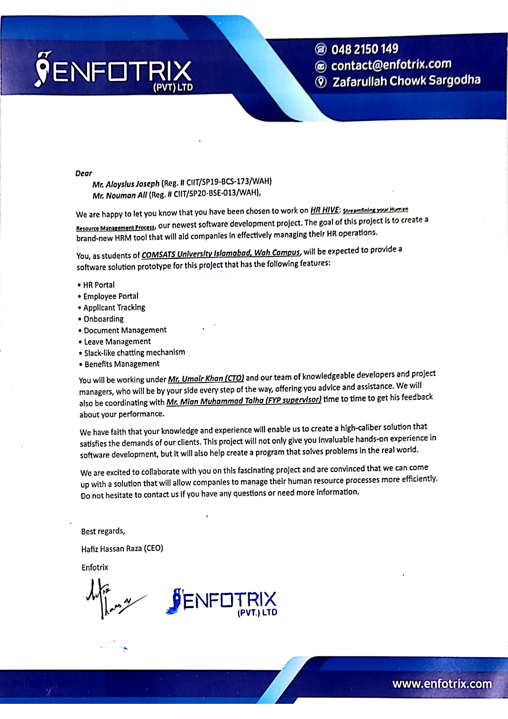

Slide 34

Questions

